Slide 1

IPAI
London Crimes and Demographics
Brian Marques |Diogo Azevedo|
Gonçalo Silva| Jose Domingues
Notes:
To use this title animation slide with a new image simply 1) move the top semi-transparent shape to the side, 2) delete placeholder image, 3) click on the picture icon to add a new picture, 4) Move semi-transparent shape back to original position, 5) Update text on slide.

Slide 2
What we will talk about
1
2
3
4
5
Intro
Data Cleaning
Database
Data Analysis
Conclusion

Slide 3

1
Objectives
What we have done:
Merge datasets with data about London boroughs, and London crimes.
Create a database and data warehouse
Query and explore the date for possible insights

Slide 4
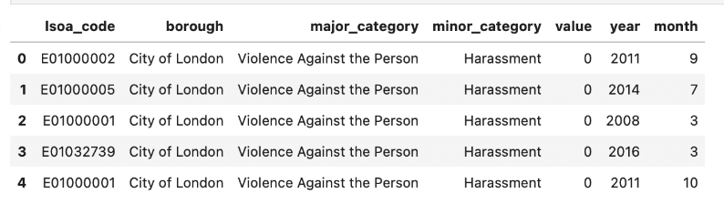
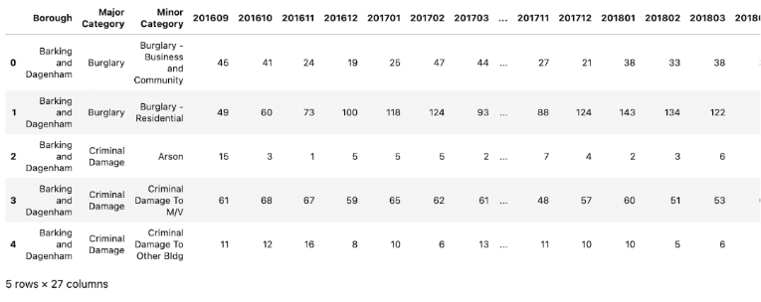
2
Data Cleaning
DF 1:
London Crimes:
We had 2 dataframes with same information, but different structure.
We wanted to merge both datasets
DF 2:

Slide 5
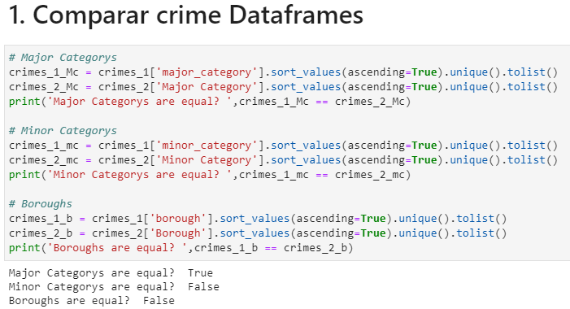
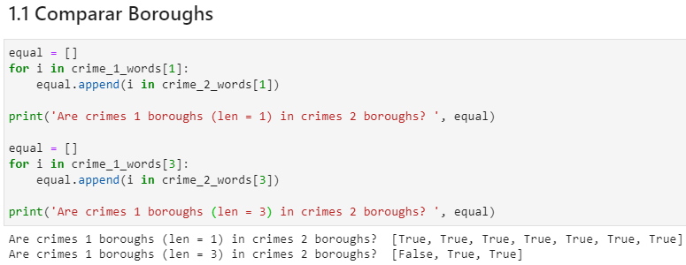
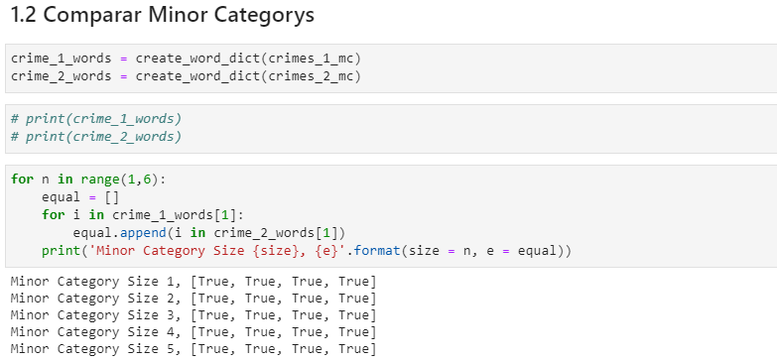
2
Data Cleaning
London Crimes:
Converted DF2 into DF1 format
Checked major and minor category similarity, to access merge viability
Checked borough names, for possible mismatches (1 mismatch)
Checked year similarities for possible row duplicates. (2016)
Merged Both datasets.

Slide 6
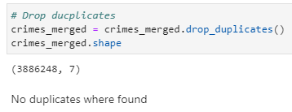
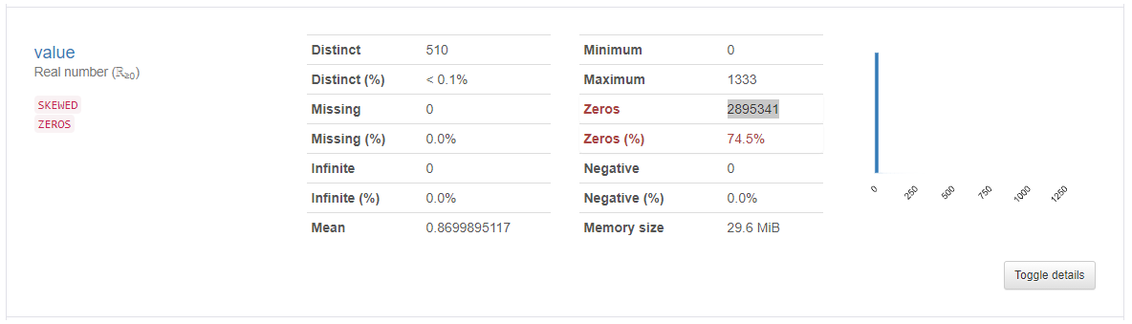
2
Data Cleaning
London Crimes:
Checked for duplicate rows
Removed value = 0
Ended with 990 907 rows

Slide 7
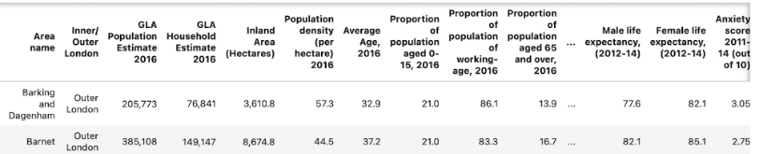
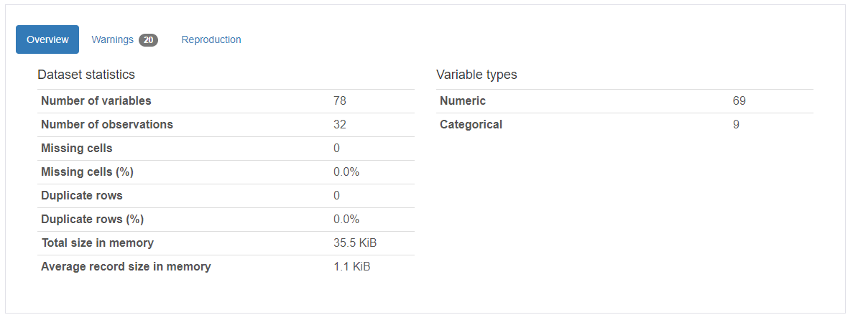
2
Data Cleaning
London Boroughs:
Dataset profiling
Removed:
Column’s code and new code.
Columns with low value range.
Columns with low information value.
Rows not corresponding to London boroughs.
Removed symbols: £
Substituted commas by points: , -> .
Null values were substituted by the column mean

Slide 8
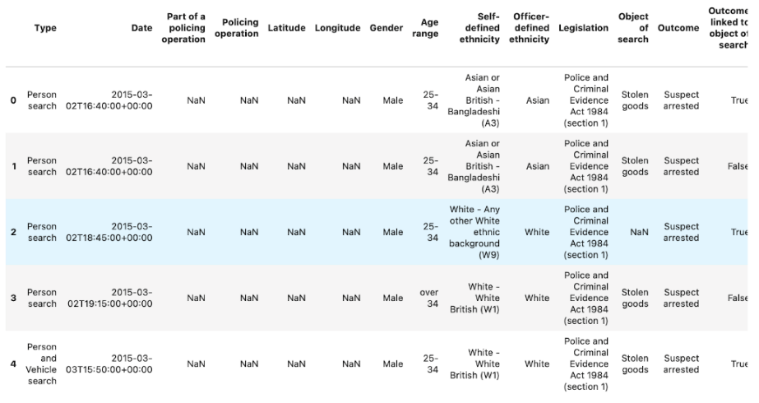
2
Data Cleaning
London Stop and Search:
Removed majority of columns ending only with the individual characteristics.
We wanted to see if some criminal profiles could be created with this dataset

Slide 9
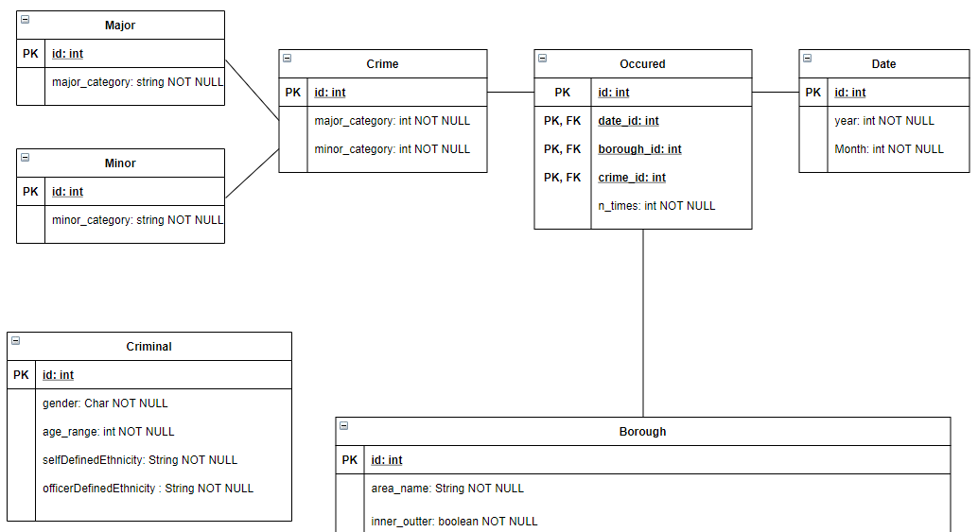
3
Integrated Model

Slide 10
3
Integrated Model

Slide 11
3
Integrated Model

Slide 12
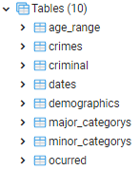
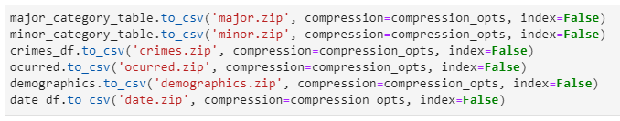
3
Data Base
Populating Tables:
Created a csv for each table.
Created the database in PostgreSQL
Loaded all tables with the csv’s created

Slide 13

4
Data Analysis
Defining query questions:
For each borough, what’s the major crime category that occurs the most within a certain year range.
What are the top 5 boroughs to live? Those that have a smaller number of crimes, bigger employment rate, and bigger salary.
We also pretend to do an exploratory analysis

Slide 14
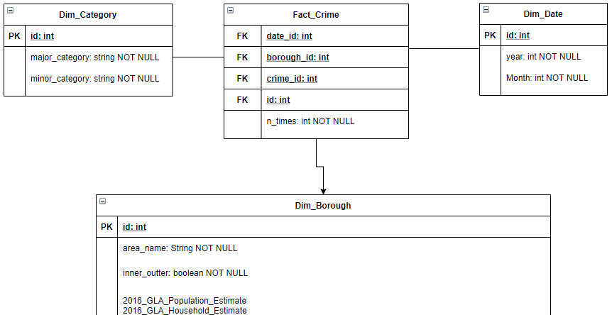
4
Data Analysis
With the questions in mind:
Simplified the ‘snowflaking’ of the original database.
Used a python notebook to create and populate the Datawarehouse.

Slide 15
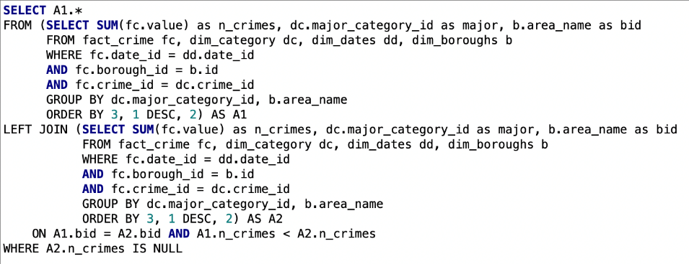
4
Query 1
Definition:
For each borough, what’s the major crime category that occurs the most.

Slide 16
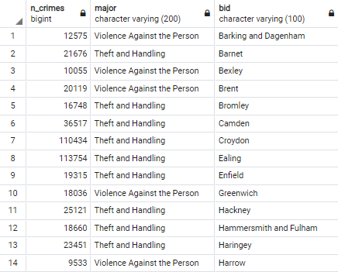
4
Query 1
Results:
Most occurred major crime is ‘Theft and Handling’ and ‘Violence against the Person’.
All other major crimes pale in comparison in terms of occurrences.
Results obtained here are further explored in the exploratory analysis.

Slide 17
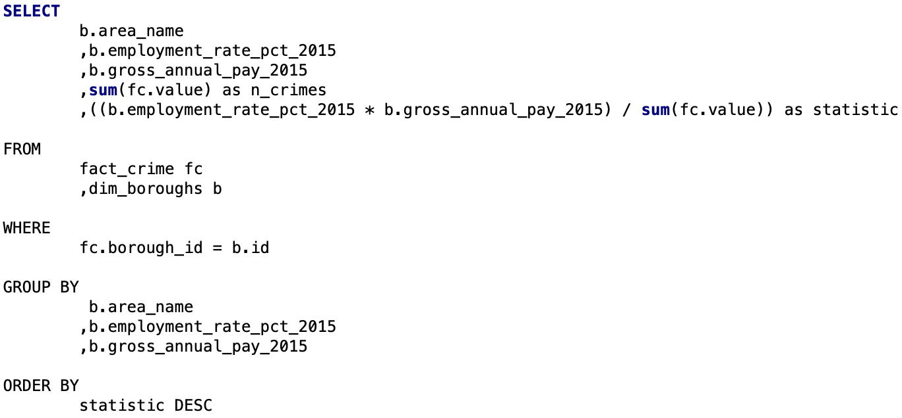
4
Query 2
Definition:
What are the top 5 boroughs to live? Those that have a smaller number of crimes, bigger employment rate, and bigger salary.
Formulated a score to relate all the features.

Slide 18
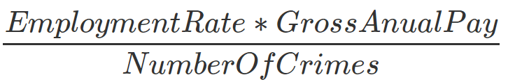
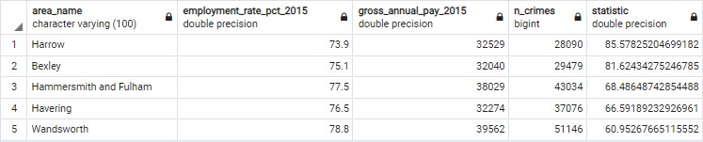
4
Query 2
Results:
Most occurred major crime is ‘Theft and and Handling’ and ‘Violence against the Person’.
All other major crimes pale in comparison in terms of occurrences.

Slide 19

4
Exploratory Analysis
Looking for insights:
We used public tableau for the data visualization.
We focused our analysis on the demographics we deemed more interesting.
Plotted each characteristic on a map plot with each borough represented.

Slide 20
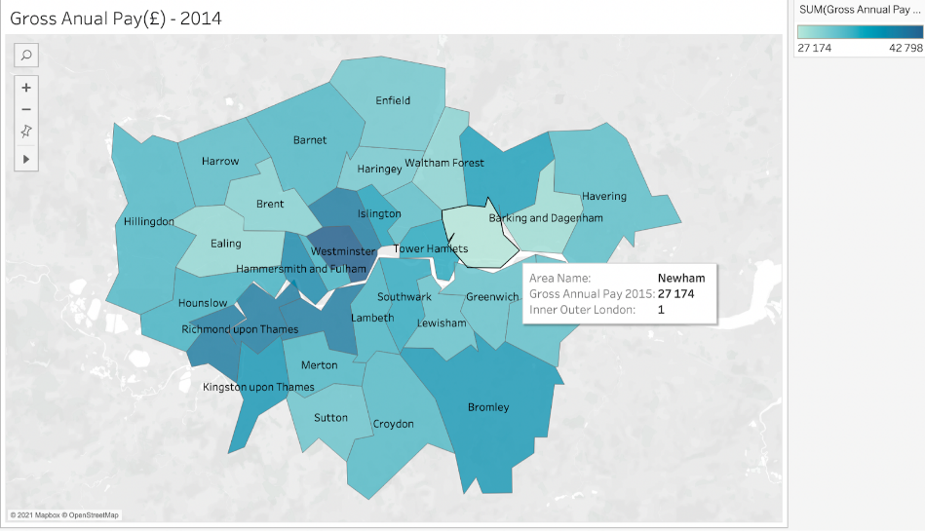
4
Exploratory Analysis
Economic and Educational Factors:
Economic and Educational factors might have impact on criminal activity.
Lower values for gross annual pay and A-C educational scores, were often accompanied by a larger volume of crimes.

Slide 21
4
Exploratory Analysis
Net Migration:
We observed that boroughs with higher volume of crimes had negative values for the Net Migration.
Crimes maybe a factor for the people leaving specific boroughs.
Net migration could be used as metric for borough quality of life.

Slide 22
4
Exploratory Analysis
Most Frequent Crimes:
Most crimes practiced are Theft Handling (other theft) and Violence against the Person (Harassment).
This crimes have most of their occurrences in specific boroughs.

Slide 23
5
Conclusions
Insights and Process:
Socio-economic factors may have impact on the number of crimes.
2 most frequent crime categories identified
Modulation, cleaning and loading is verry important for the operation workflow

